Slide 1
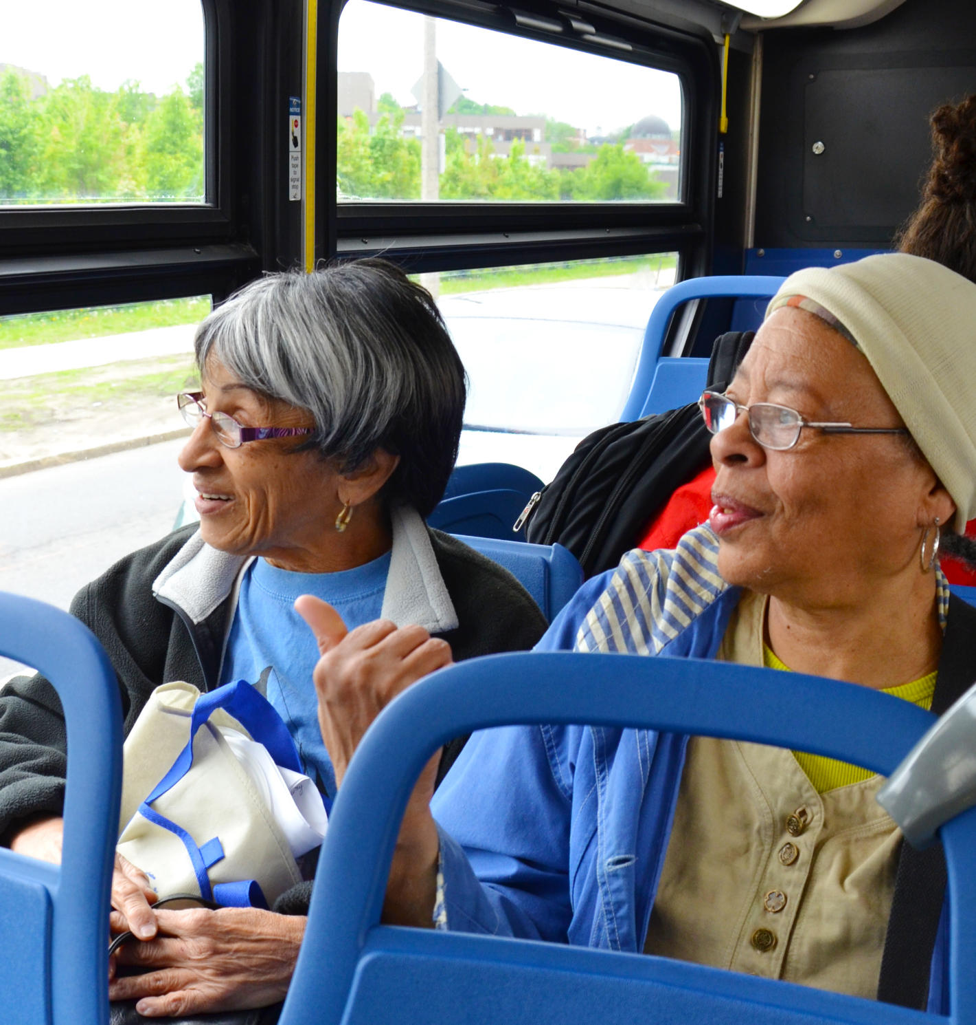

5310 Basics
All Grantee Meeting
June 18, 2025

Slide 2
FTA Section 5310 – Eligibility
Enhanced Mobility of Seniors and Individuals with Disabilities (FTA Section 5310)
State DOTs, Designated Recipients, State/Local Governmental Authorities that operate transportation services to improve mobility for older adults and people with disabilities.
Capital and Operating Projects should exceed the requirements of the ADA and improve access to accessible transportation.
FTA Circular 9070.1H

Slide 3
FTA Section 5310 – Capital Projects
Capital Projects
Local Match: 20%
Bus or van purchase
Enhanced bus lift, ramp, or securement device
Bus signage, bus shelter, curb cuts and sidewalks
Mobility Management or travel training programs
*match amount may vary by state or awarding entity
FTA Circular 9070.1H

Slide 4
FTA Section 5310: Operating Projects
Operating Projects
Local Match: 50%
Start-up, new or pilot projects
Sub-contracted service
Supplement same-day or demand responsive services
A few examples:
Taxi services, Rideshare, Volunteer Driver Programs, Non-Emergency Medical Transportation
*match amount may vary by state or awarding entity
FTA Circular 9070.1H

Slide 5
How Do I Get 5310 Funding?
Identify your regional classification.
Rural, Small-Urban, Large Urban
Identify the recipient for your region/community.
Determine/Confirm eligibility to receive funding.
Timetable for application submission.
Inclusion into Coordinated Public Transit–Human Services Transportation Plan

Slide 6
Planning for Implementation
Coordinated Public Transit Human Services Transportation Plan
Assessment of Available Resources
Assessment of Transportation Needs
Strategies, Activities, or Projects
Priorities for Implementation based on resources
Metropolitan Planning Organization or Direct Recipient manages the local planning
Updated every 5 years, but should incorporate ideas from conversation with human services providers

Slide 7
Planning for Implementation, cont.
Advisory Groups and Coalitions
Brings human services providers to the table and discuss transportation issues from their perspective
Great way to develop relationships and build a trusted network of community providers
When funding becomes available, your group should have the data and information ready to develop an application for a quick turnaround!

Slide 8
Planning for Implementation, cont.
Advisory Groups and Coalitions
FTA Section 5310 funding encourages coordination and requires human services agencies to be part of the transit planning process.
Allows valuable support for projects to be ‘shovel-ready’ once the project is funded
Allows the project to be sustainable after the funding has expired.

Slide 9
Resources
FTA Section 5310 Profiles
Coordination Committee Toolkit
Community Engagement Toolkit: Essentials for Planning and Facilitating Meaningful Conversations
NADTC Webinars on Coordination
FTA Section 5310 Program Overview – webinars

Slide 10
Group Discussion
Have you considered applying for 5310?
What has prevented you from applying for 5310?
If you currently receive 5310, what was the most challenging part of applying?
What do you wish you had known before you applied?

Slide 11



Contact Information
Email: contact@nadtc.org
Toll-free: 866-983-3222
Website: www.nadtc.org
Find us on Facebook, YouTube and LinkedIn

