Slide 1
Providing Person-Centered Transportation Information to Older Adults and People with Disabilities
August 23, 2017

Slide 2
Webinar Logistics
This webinar is being recorded
To ask a question, type it into the chat box to the left of your screen. Chat capabilities for Q&A will be enabled after the presentation.
Captioning is being provided for this webinar. To access captioning, press control and F8 on your keyboard.
If you are having difficulty with Blackboard functioning, please contact Blackboard Technical Assistance:
(877) 382-2293

Slide 3
MISSION: To promote the availability of accessible transportation options that serve the needs of Older Adults, People with Disabilities, Caregivers and Communities.
MAJOR OBJECTIVES:
Person-centered technical assistance and information & referral
Training: webinars, online courses/forums
Interactive communication and outreach strategy
Coordination and partnership strategy, including stakeholder engagement
Investment in community solutions
Independent program evaluation
KEY STAKEHOLDERS: Transportation providers; human services providers; disability organizations; Area Agencies on Aging; State Departments of Transportation; Tribal Transit and Tribal Elder Services; FTA; ACL; and more....
UPCOMING EVENTS & PRODUCTS include an update on Innovations developed by the 6 NADTC projects; an online mini-course on “Transportation & Caregiving”; the 2017 Trends Report to be published later this year; and the 3rd National RTAP Technical Assistance Conference in Omaha, NE, 10/29-11/1/17
www.nadtc.org

Slide 4
NADTC’s Information and Assistance Initiative
Transportation Information and Assistance includes
varied approaches that communities may adopt to
respond to ride requests and answer questions about
transportation options. These may include the following:
One-Call/One-Click Transportation Resource Centers
Mobility Management
Aging and Disability Resource Centers
Area Agency on Aging (AAA) or Center for Independent Living (CIL) Information and Referral/Assistance Programs
2-1-1

Slide 5
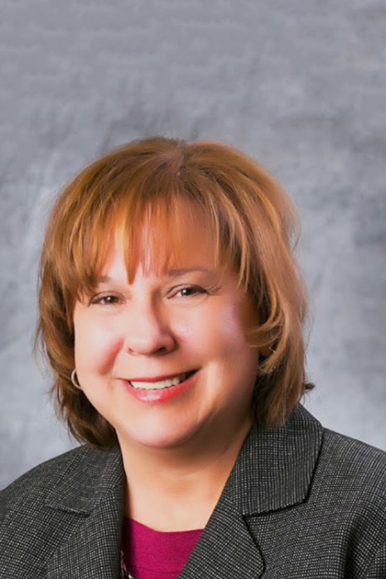
Our Presenter today
Roberta Habowski, Mobility Project Manager
Area Agency on Aging 1-B, Southfield, MI

Slide 6
The Evolution of
myride2
Roberta Habowski
Area Agency on Aging 1-B

Slide 7
Prior to myride2
1995 AAA 1-B Advisory Board conducted Ad-Hoc study- lack of resources for older adults making decisions about continued mobility
You Decide: Senior Driving
Awareness Program
1997-2007
Met monthly at various senior centers, topics included; safe driving, medications + driving, transportation, road commission, etc.
Mobility Options Counseling Project
2008-2011

Slide 8
All of us are going to outlive our ability to drive by 7-10 years
“If I can’t drive, I might as well be dead.”

Slide 9
Getting Ready
In 2010, AAA 1-B partnered with Jewish Family Service (JFS) to apply for Job Access Reverse Commute (JARC) and New Freedom federal funding – first time Mobility Management was a component
Establish a “one-call, one-click” Mobility Management Service

Slide 10
One Year of Research and Development
Questions
What did we want to include?
How in-depth?
Website?
Best Practices
National Organizations
Iowa DOT
United we Ride
NCST (now NADTC)
Beverly Foundation
National Center for Mobility Management
Easter Seals
Budget
Technology needs
Branding/Marketing Plan

Slide 11
Overview
Toll-free multilingual phone line - 855-myride2
Live transfers to transit providers
Rider only has to give information one time
Interactive web site – can search for providers, request a ride, get information
Available in Oakland and Macomb counties
Older Driver Safety information

Slide 12
Important Factors
AAA 1-B In-Kind in Beginning
Admn
Space and utilities
Tech needs
Communications Dept.
Finance Dept
HR
Current Information and Assistance Center
Student Intern
Utilizing I&A Infrastructure
Used same system to keep call records
Used current providers in database
Used training guide as a template
Reviewed provider vetting

Slide 13
Decisions, Decisions
Worked with Communications Dept. and JFS
Name of service – should it “mean” something? Coincide with phone number? Domain available?
Brand – graphic designer
Web Design – used an outside contractor

Slide 15
Next Steps
Research Providers – Public and Private
Enter Providers into Excel database as well as Wordpress for website
Research zip codes for service area – put in Excel for web designer to include in search feature
Hire and train staff – started with 2 PT Mobility Specialists (now have 2 FT, soon to be 3.5 FT)
Complete website
Add myride2 “pages” to I&A system

Slide 16
Provider Information
New Transportation Provider Initial Call Sheet –
(make sure they are on MDOT licensing website)
Name of Company: _________________________________________________________
Contact Person: ______________________________________________________ _____
Business Address: __________________________________________________________
Phone#: ________________________________ Website address: _________________
How many vehicles? __________ What kind? _________________________________
How long have you been in business? _______________________________________
What areas/counties do you serve? ___________________________________________
What are your hours? ______________________________________________________
What are your rates for private pay customers?
Wheelchair: ______________________________________________________________
Ambulatory: ______________________________________________________________
_________________________________________________________________________
Additional Info: ___________________________________________________________

Slide 17
Initial Call Worksheet
Call taken by ______________ How did they hear about us? ______________________ Date______________
myride2
1. Name of caller_____________________________________ Phone number_________________________
2. Name of rider _____________________________________ Phone number_________________________
3. Address of rider ____________________________
4. Ride originating at home address?______ If not; address for pickup________________________________
5. Rider’s age ____________ 6. Is rider a veteran? ______________
7. Is the rider enrolled in MiChoice program? _____ If so, they should contact their Supports Coordinator
8. Is the rider on Medicaid? ________ If so, they can call LogistiCare for medical rides. (1-866-569-1902)

Slide 18
9. Rider disabled? _________
10. Rider uses wheelchair? ____________ Can they transfer from wheelchair themselves? __________
11. Rider uses a walker? __________ Rider uses a cane? __________ Other disability? __________________
12. Curb to Curb? _________ Door to Door? _________ Door through Door? _________ Escorted? _________
13. Destination name & address _______________________________________________________________
14. Date(s)/times ride needed _________________________________________________________________
15. Is it okay to share info with providers? _______________________________________________________

Slide 19
16. Special call notes_____________________________________________________________________
17. Calculate mileage ________________________________________________________________________
18. Research providers and list prices, etc below.
__________________________________________ ___________________________________________
Status/Follow up - initial and date ______________ ____________________ ____________________
Closed in Harmony___________ Date________________

Slide 20
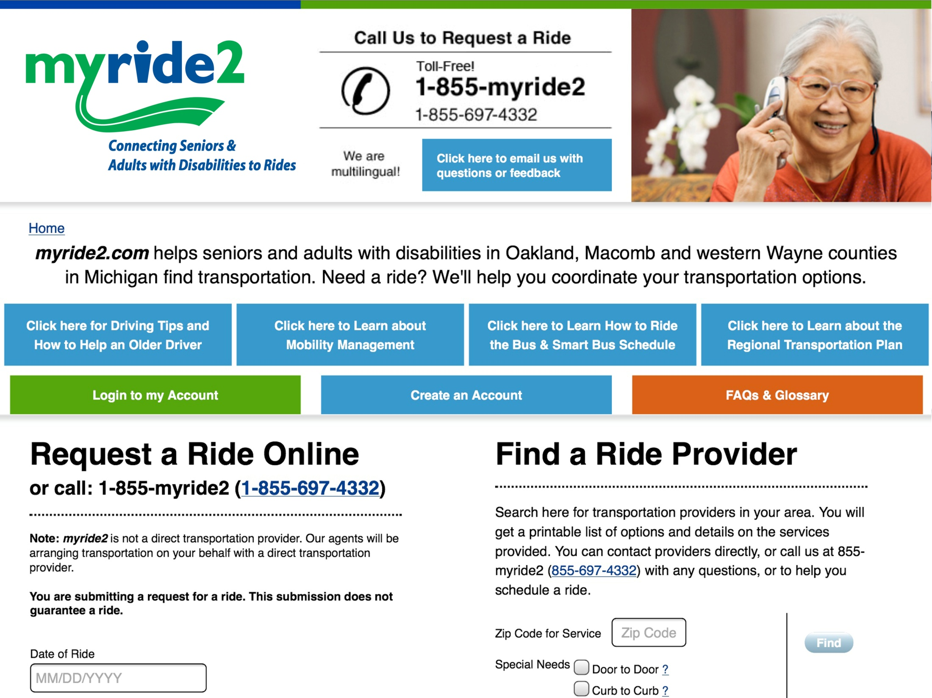

Slide 22
Articles in Agency Publications
lease
Sent info and rack cards to:
Senior Centers
Physician’s offices
Hospitals
Other Human Service Organizations – Centers for Independent Living, Jewish Family Service
Libraries

Slide 24
Partners Along the Way
Jewish Family Service
SMART – public provider
Disability Network Oakland Macomb
The Senior Alliance (AAA 1-C)
Advocacy Groups
AARP
Michigan DOT
Community Transportation Association of America
Local Metropolitan Planning Organization
Faith Based Groups
Healthcare Organizations
Regional Transportation Authority of Southeast Michigan

Slide 25
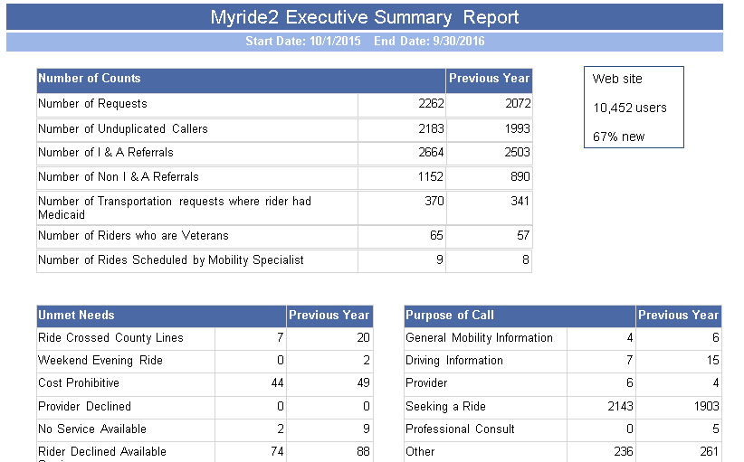

Slide 26
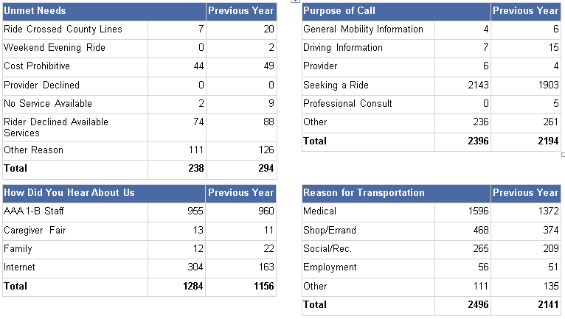

Slide 27
Mobility
Management
Advocacy
Mobility Options Counseling
Driving/driving retirement
Travel Training-
One on one or
Group trainings
Transportation Referrals –
One on one assistance to find
best option.
Schedule Rides-
variety of providers

Slide 28
Future
Addition of Travel Training
Expansion in to Detroit service area
Expansion to other RTA counties
Scheduling Software

Slide 29
Network
Network
Network

Slide 30
Questions??
Thank you!
Roberta Habowski
Area Agency on Aging 1-B
248-262-9211
rhabowski@aaa1b.com

Slide 31
Toll-free: 1-866-983-3222
contact@nadtc.org
www.nadtc.org

