Slide 1



Laura Loe (she/her); Program Manager, Find a Ride, Hopelink Since 2018, Hopelink has been enacting the vision of King County Mobility Coalition, and many regional partners, through a One-Call/One-Click system. The project expanded our Find a Ride transportation service discovery site to include a ground-breaking trip planner. This is a critical step forward for our multi-phase roadmap to increase mobility access across Pierce, King, and Snohomish Counties. Our new trip planner focuses on services essential for older adults, people with disabilities, and rural transit riders. Another important project focus is ensuring accessibility for blind and low-vision travelers.
Coalition Approaches to Transit Technology
Notes:
Today I’ll be discussing how Hopelink and the King County Mobility Coalition have rooted our One-Call/ One-Click Find a Ride technology program in a unique inclusive planning framework.

Slide 2



Inclusive Planning: Then & Now
Transit Planning 4 All Grant (2018-2020)
Evaluated “how do older adults, people with disabilities, and caregivers find and secure transportation?”
Learn more at https://www.kcmobility.org/kcmc-inclusive-planning-grant
Notes:
You can read about our inclusive planning process on our website: https://www.kcmobility.org/kcmc-inclusive-planning-grant Our Mobility for all Transportation summit graphic in this slide tells the story of how travelers in our region need better service cooperation, and bold solutions. Our work focuses on mobility choices for older adults and people with disabilities and their caregivers.

Slide 3
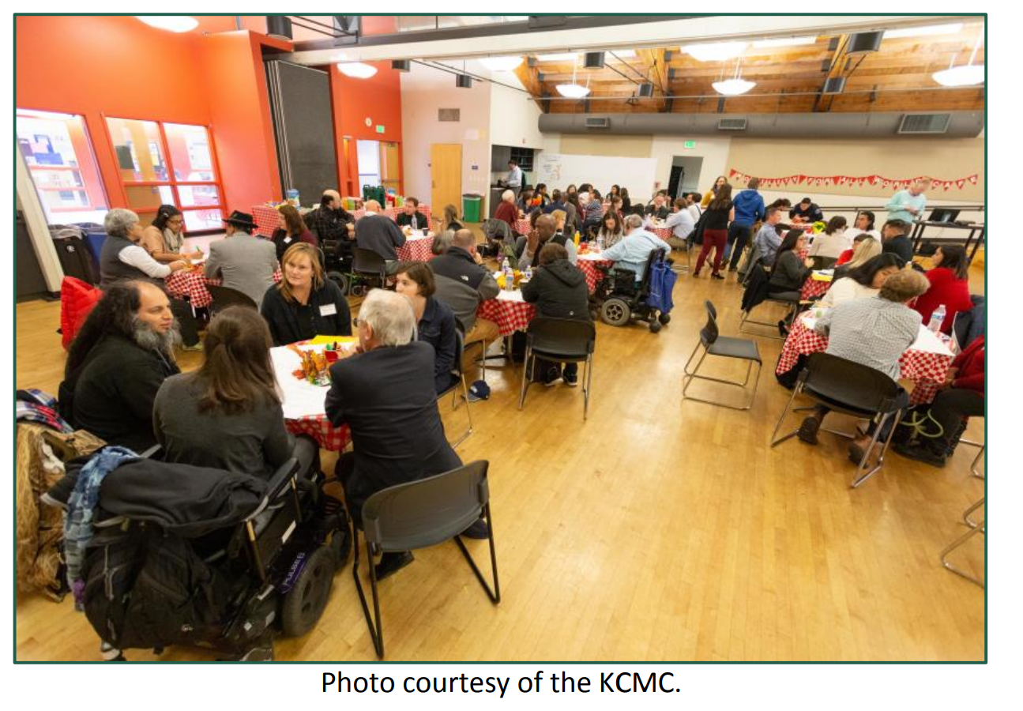
Inclusive Planning Report
Learn more at https://www.kcmobility.org/kcmc-inclusive-planning-grant
Notes:
You can read about our inclusive planning process on our website: https://www.kcmobility.org/kcmc-inclusive-planning-grant Our Mobility for all Transportation summit graphic in this slide tells the story of how travelers in our region need better service cooperation, and bold solutions. Our work focuses on mobility choices for older adults and people with disabilities and their caregivers.

Slide 4

What is a Coalition?
Our Trip Planner was created in community, with over 30 organizational partners across Pierce, King, and Snohomish Counties.
Learn more about our project’s governance, funding, roadmap, and more at https://www.kcmobility.org/ococ

Slide 5







Program Roadmap
Phase 1a: Service Discovery & Trip Planning
Phase 1b: One-Call Phone Coordination & Rider Profiles
Phase 2: Intake, Eligibility Determination, & Enrollment Verification
Integration with Sidewalk data (AccessMap)
Trip Brokering (+ Trip Booking)
Payment and Billing
Notes:
We have about 50 transportation services in our Trip Planner and 100 on our FindARide.org website’s Provider List. We are still working on our 3-county referral coordination practices. We hope to receive our FTA contract for Phase 2 but have begun our Phase 2 inclusive planning work in advance of that funding award.

Slide 6




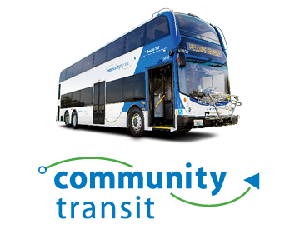



























Find a Ride’s Transportation Services Phase 1
NEMT
Access
Hyde
Shuttle
Notes:
The trip planner has over 45 different transportation options listed across King, Pierce, and Snohomish counties. I won't be reading all the names of these services on this slide today, but they are listed in the alt text of this slide deck which I will provide you after our presentation.

Slide 7
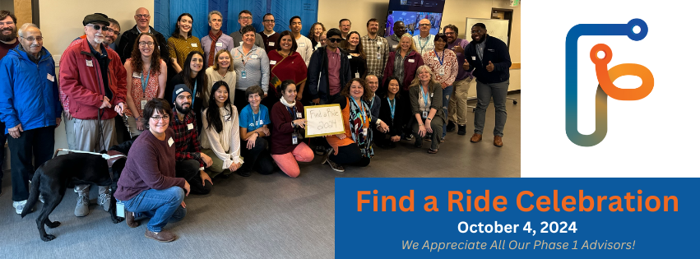
Thanks to our Advisory Committee!
Notes:
Our governance structure includes our King County Mobility Coalition, Hopelink’s Mobility Team, Our Find a Ride Advisory Committee, Technical Advisors and more!

Slide 8
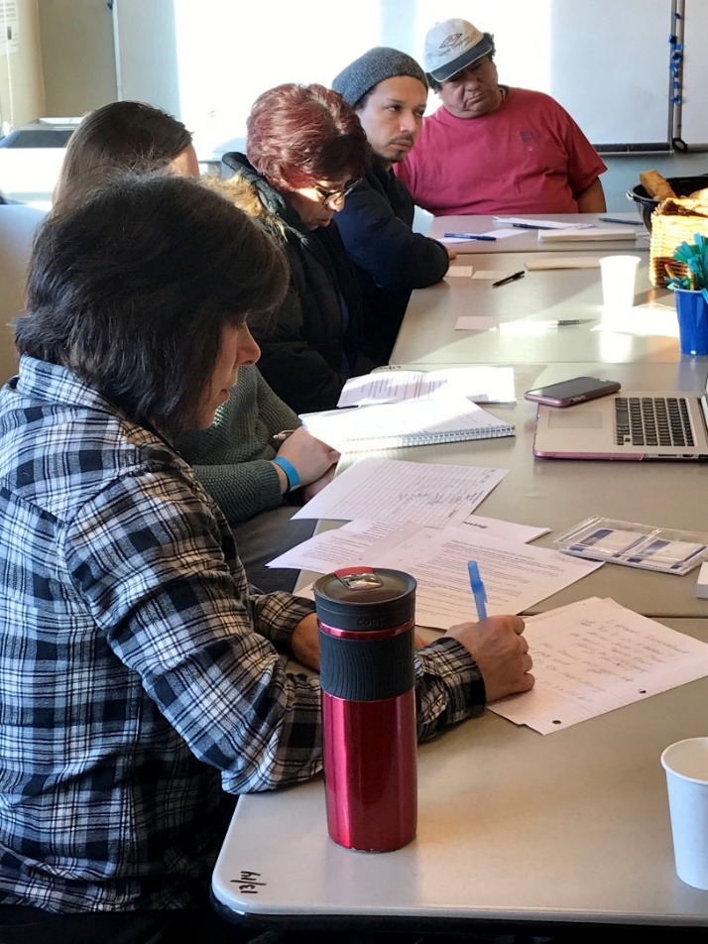
Find a Ride’s Governance
Mobility for All
Hopelink
King County Mobility Coalition
Advisory Committee
Technical Advisors
Ad Hoc Community
Notes:
Find a Ride began with an inclusive planning process back in 2018, some of you were probably there! This slide shows the initial discussions that led to this program. On the right side of the slide is our governance structure. We have lots of amazing advisors on the project, some of you are here today!

Slide 9


Education Materials
Notes:
The National Aging and Disability Transportation Center (NADTC) gave us a grant for the Every Ride Counts campaign. Print and digital images went through a rigorous inclusive planning process, too. We focused on simple images with large text and strong contrast. We wanted a variety of people from different backgrounds.

Slide 10
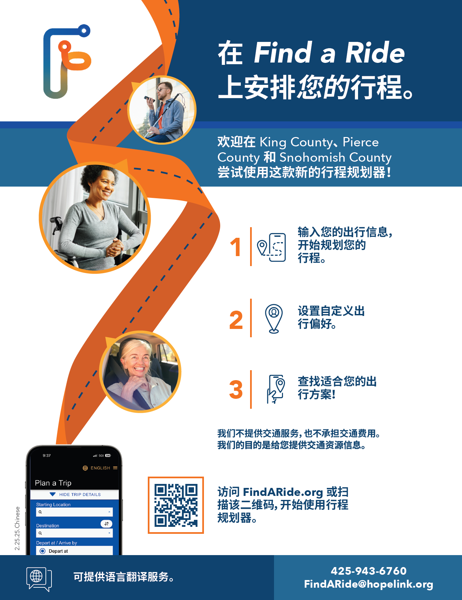
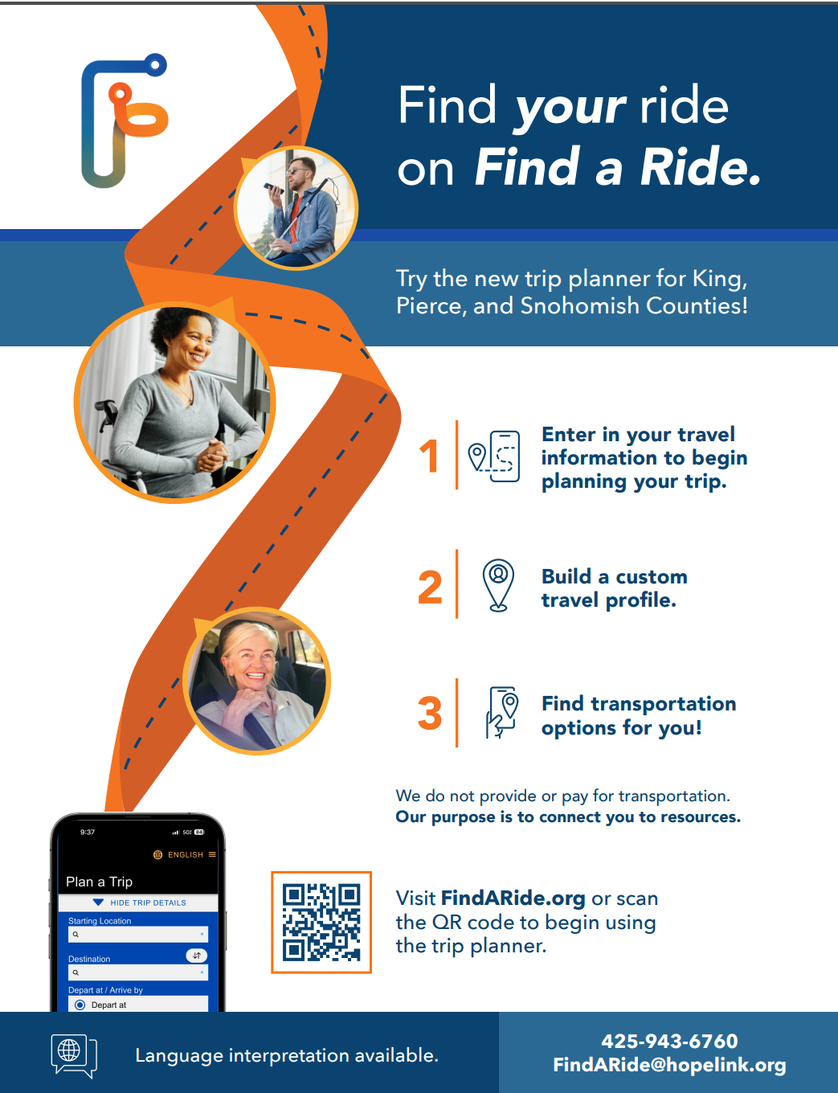
Two examples of marketing materials in Chinese and English

Slide 11
Data Quality Assurance
Mobility Management
Coalition Partners
Data Quality
Transit Agencies
Non-Profit Agencies
Tribal Transportation
Client and Community Feedback

Slide 12

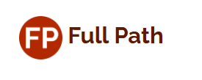

Thanks to our project vendors

Slide 13



Thanks to our funding partners
We received Phase 1 funding through 2027 from WSDOT.
We were selected for Phase 2 funding through the FTA ICAM grant in June 2024.

Slide 14
Thank you!
Your feedback fuels our commitment to excellence and drives us to continually enhance the trip planning experience. Encourage community members to provide feedback by emailing FindARide@hopelink.org
Laura Loe
Program Manager, Find a Ride, Hopelink LLoe@hopelink.org
Staci Sahoo
Director, Mobility Management, Hopelink
SSahoo@hopelink.org

